Slide 1
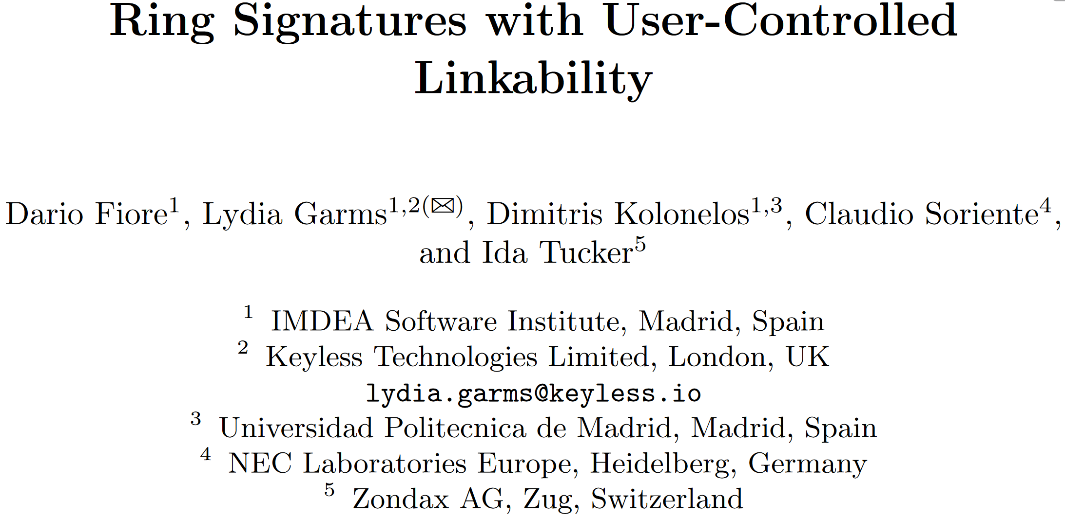
ESORICS 2022
刘钰琳
2024.4.12

Slide 2
Content
Recall to Group signatures and Ring signatures
Group signatures
Ring signatures
Abstract
Introduction
User-Controlled linkability
Contribution
Ring Signatures with User-Controlled Linkability

Slide 3
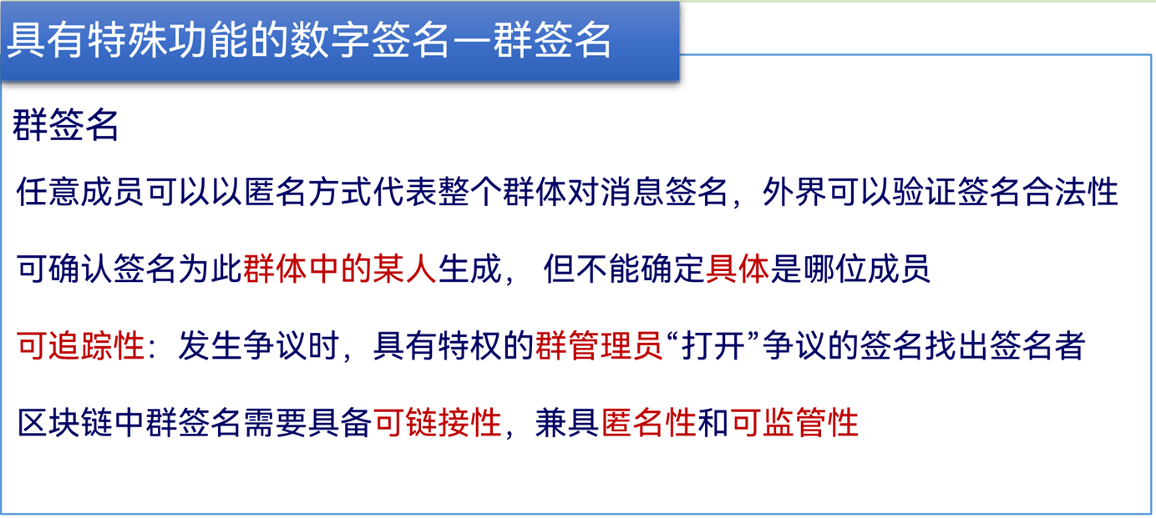
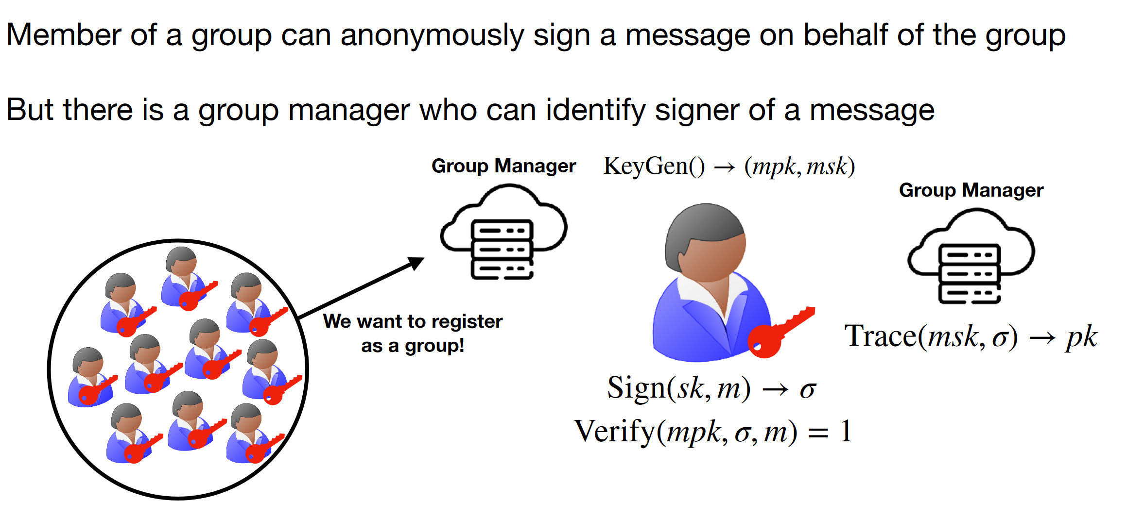
Introduction - Group Signatures

Slide 4
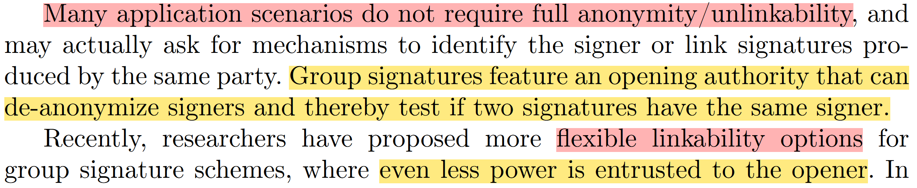
Introduction - Group Signatures
从opener入手
从signer入手

Slide 5
Introduction - Group Signatures
In [HLC+11,HLC+13,SSU14,KTY04] group signatures with an authority who can test whether two signatures have the same signer but cannot open signatures were introduced.
Reference:
[HLC+11] Hwang, J.Y., Lee, S., Chung, B.-H., Cho, H. S., Nyang, D.: Short group signatures with controllable linkability. In: Workshop on Lightweight Security & Privacy: (LightSec) (2011)
[HLC+13] Hwang, J.Y., Lee, S., Chung, B.-H., Cho, H.S., Nyang, D.H.: Group signatures with controllable linkability for dynamic membership. Inf. Sci. 222, 761–778 (2013)
[SSU14] Slamanig, D., Spreitzer, R., Unterluggauer, T.: Adding controllable linkability to pairing-based group signatures for free. ISC 2014.
[KTY04] Kiayias, A., Tsiounis, Y., Yung, M.: Traceable signatures. EUROCRYPT 2004.

Slide 6
Introduction - Group Signatures
Group signatures with message-dependant opening [SEH+12,OSEH13, LJ14,LMN16] introduce an additional entity, the admitter, who can specify messages such that the corresponding signatures can be opened.
Reference:
[SEH+12] Sakai, Y., Emura, K., Hanaoka, G., Kawai, Y., Matsuda, T., Omote, K.: Group signatures with message-dependent opening. In: Abdalla, M., Lange, T. (eds.) Pairing 2012.
[OSEH13] Ohara, K., Sakai, Y., Emura, K., Hanaoka, G.: A group signature scheme with unbounded message-dependent opening. In: ASIA-CCS (2013)
[LJ14] Libert, B., Joye, M.: Group signatures with message-dependent opening in the standard model. In: Benaloh, J. (ed.) CT-RSA 2014.
[LMN16] Libert, B., Mouhartem, F., Nguyen, K.: A lattice-based group signature scheme with message-dependent opening. In: Manulis, M., Sadeghi, A.-R., Schneider, S. (eds.) ACNS 2016.

Slide 7
Introduction - Group Signatures
In [GL19,FGL21], group signatures are originally unlinkable, but later on can be converted to linkable signatures by an oblivious “converter”.
Reference:
[GL19] Garms, L., Lehmann, A.: Group signatures with selective linkability. In: PKC (2019)
[FGL21] Fraser, A., Garms, L., Lehmann, A.: Selectively linkable group signatures stronger security and preserved verifiability. CANS 2021.
Group signatures with certified limited opening [ZWC19] introduce a certifier, instead of an admitter, who can certify a particular opener to allow them to open signatures on messages within a particular context.
Reference:
[ZWC19] Zhang, T., Wu, H., Chow, S.S.M.: Structure-preserving certificateless encryption and its application. In: Matsui, M. (ed.) CT-RSA 2019.

Slide 8
Introduction - Group Signatures
Another line of work [BCC04,BFG+13,CDL16b,CDL16a] considers scenarios where a so-powerful authority is undesirable, and achieves linkability by including a one-way function of the signing key and a “scope” chosen by the signer—also known as “pseudonym”—in each signature, so that two signatures with the same pseudonym can be trivially linked.
Reference:
[BCC04] Brickell, E.F., Camenisch, J., Chen, L.: Direct anonymous attestation. In: ACM CCS (2004)
[BFG+13] Bernhard, D., Fuchsbauer, G., Ghadafi, E., Smart, N.P., Warinschi, B.: Anonymous attestation with user-controlled linkability. Int. J. Inf. Secur. 12(3), 219–249 (2013)
[CDL16a] Camenisch, J., Drijvers, M., Lehmann, A.: Anonymous attestation using the strong Diffie Hellman assumption revisited. In: Franz, M., Papadimitratos, P. (eds.) Trust 2016.
[CDL16b] Camenisch, J., Drijvers, M., Lehmann, A.: Universally composable direct anonymous attestation. In: Cheng, C.-M., Chung, K.-M., Persiano, G., Yang, B.-Y. (eds.) PKC 2016.

Slide 9
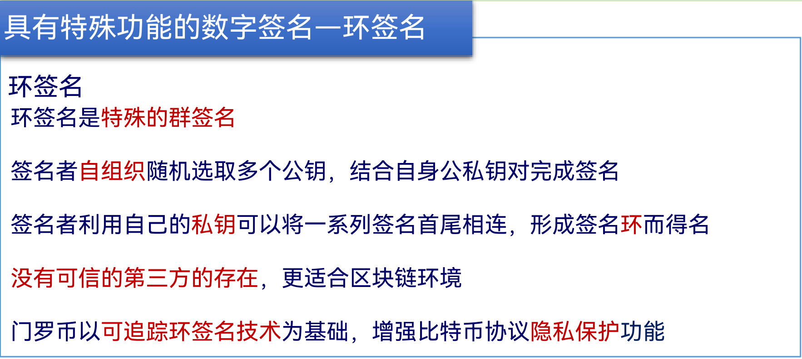
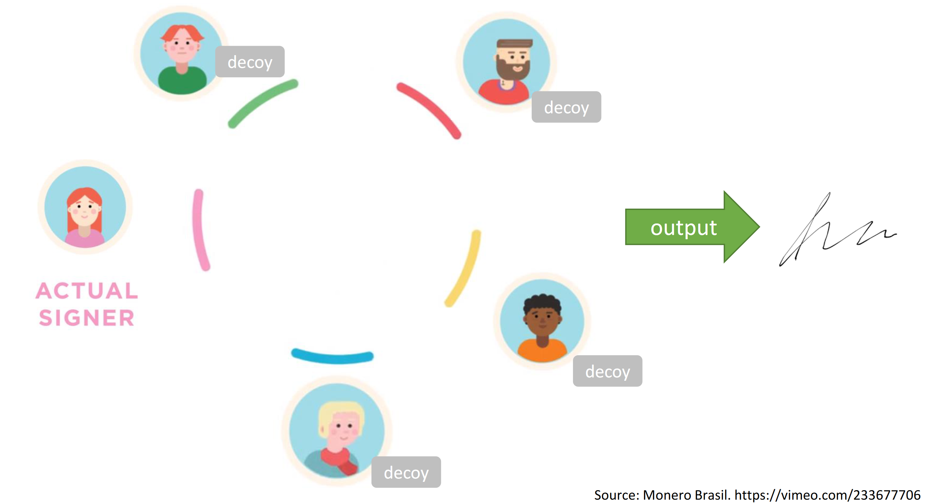
Introduction - Ring Signatures

Slide 10
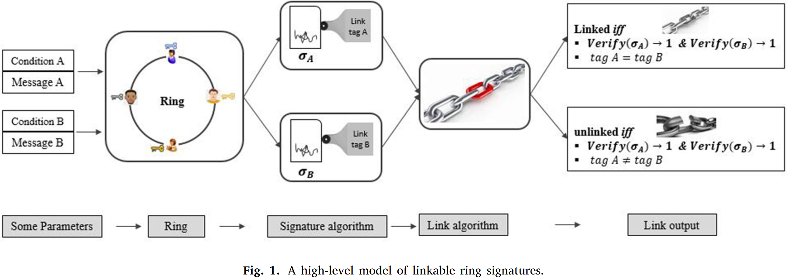
Introduction - Ring Signatures

Slide 11
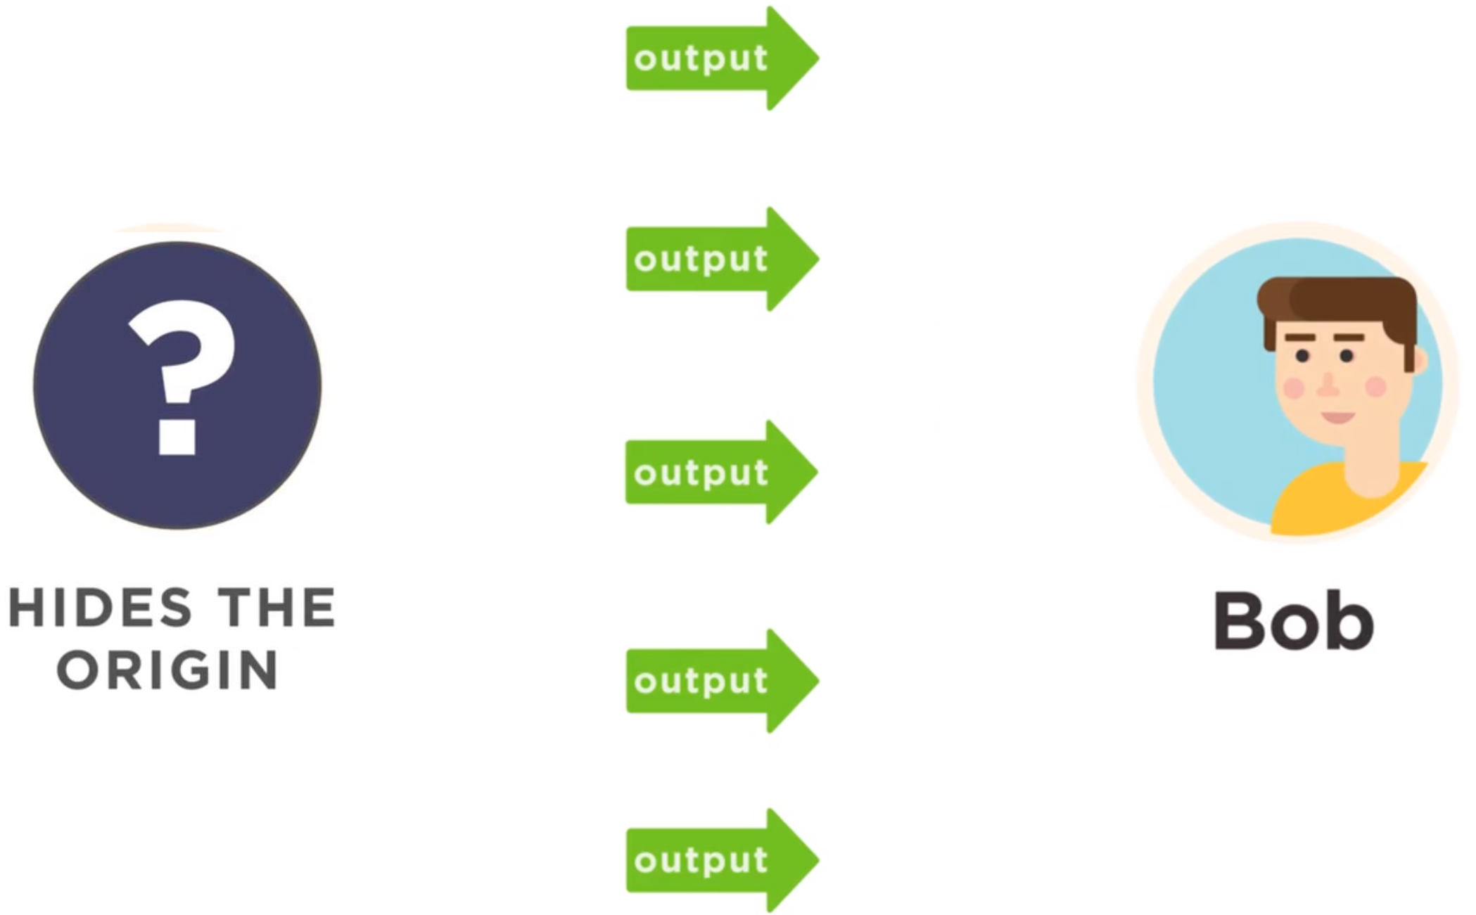
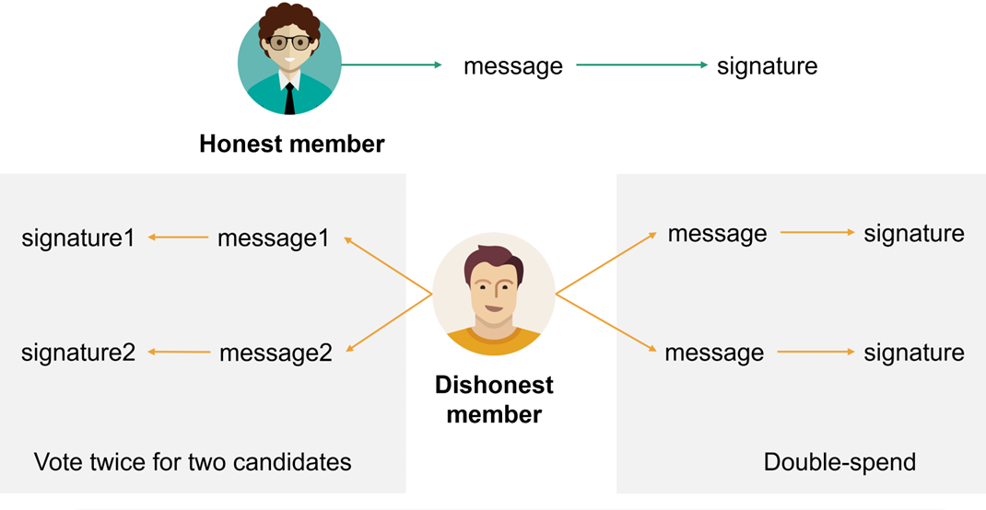
Introduction - Ring Signatures
使用环签名保护发送方身份隐私和交易金额隐私
门罗币
电子投票

Slide 12
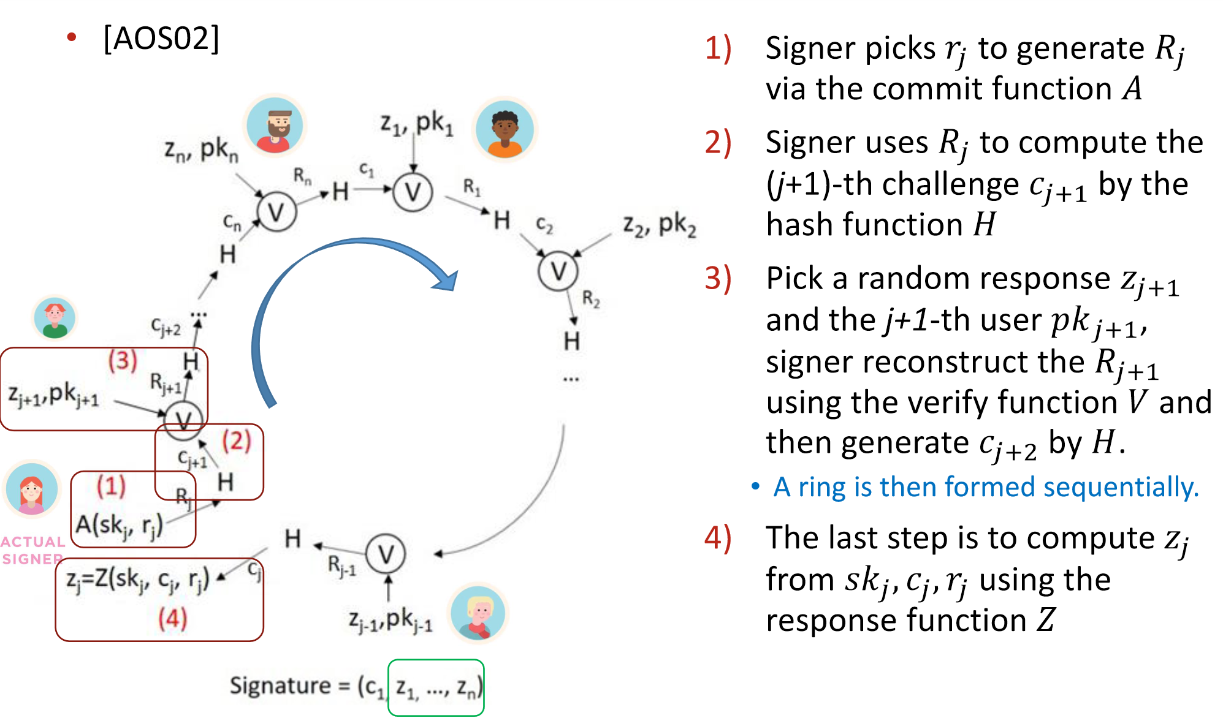
Introduction - Ring Signatures
[AOS02] Abe, M., Ohkubo, M., Suzuki, K.: 1-out-of-n signatures from a variety of keys. In: ASIACRYPT 2002.
Notes:
为什么可以验证通过？

Slide 13
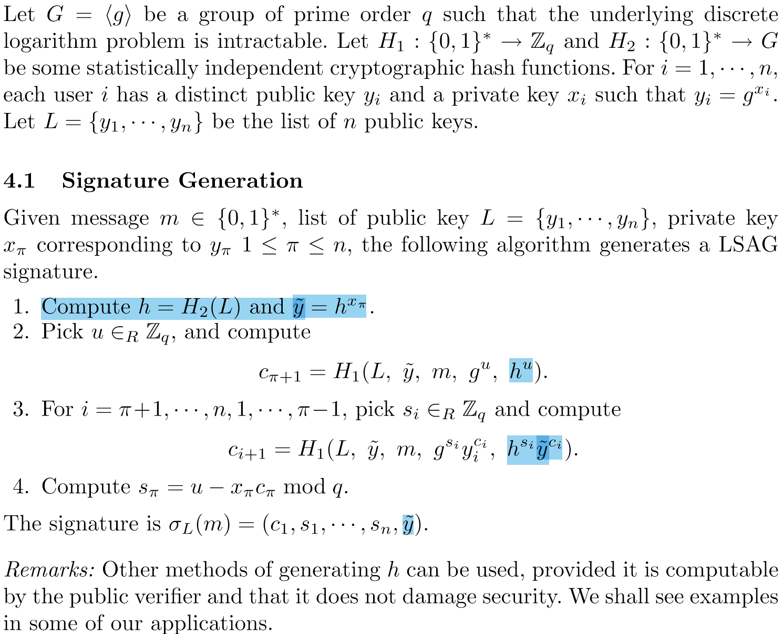
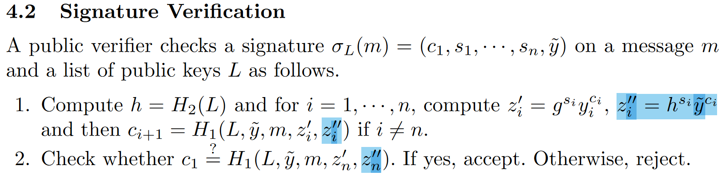
Introduction - Ring Signatures
[LWW04] Liu, J. K., Wei, V. K., & Wong, D. S. (2004). Linkable spontaneous anonymous group signature for ad hoc groups. In Information Security and Privacy: 9th Australasian Conference, ACISP 2004.

Slide 14
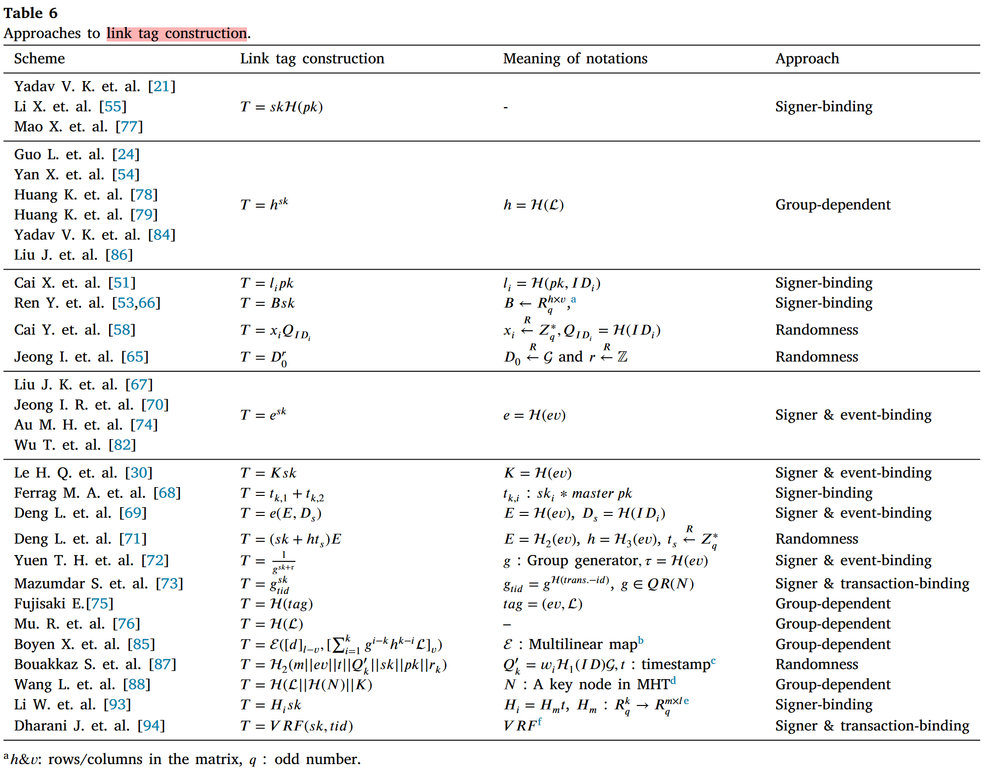
Introduction - Ring Signatures
Odoom, J., Huang, X., Zhou, Z., Danso, S., Zheng, J., & Xiang, Y. (2023). Linked or unlinked: A systematic review of linkable ring signature schemes. Journal of Systems Architecture, 134, 102786.

Slide 15
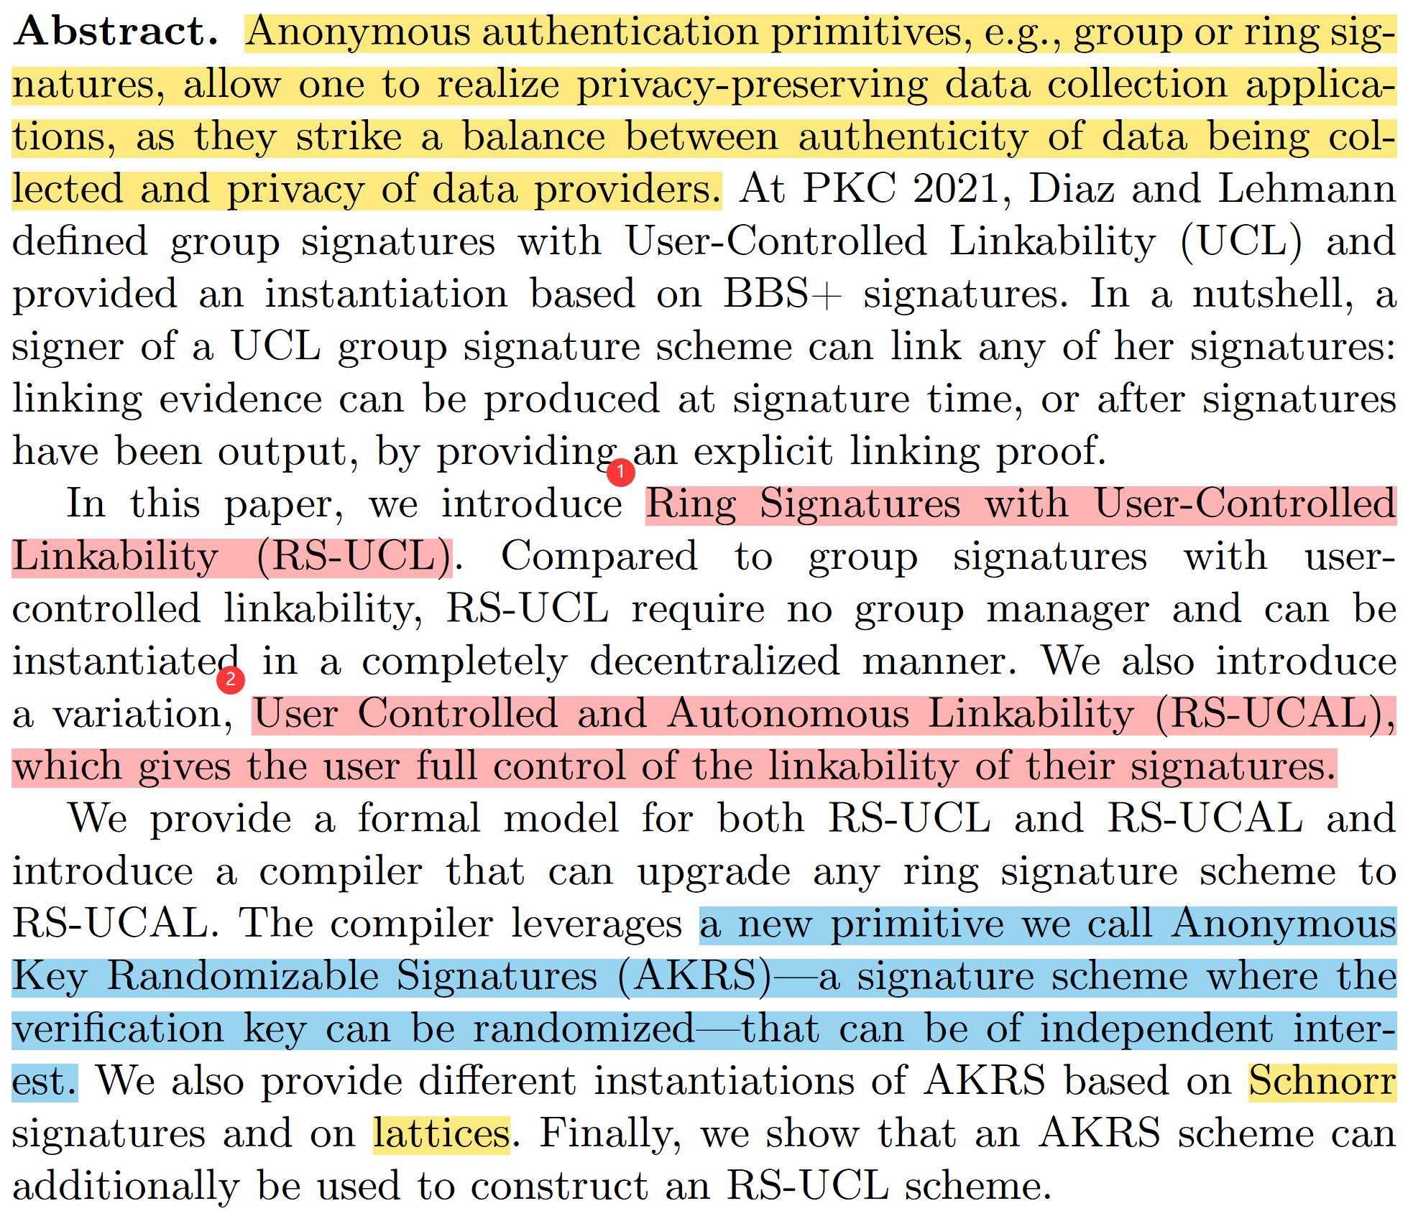
Abstract

Slide 16
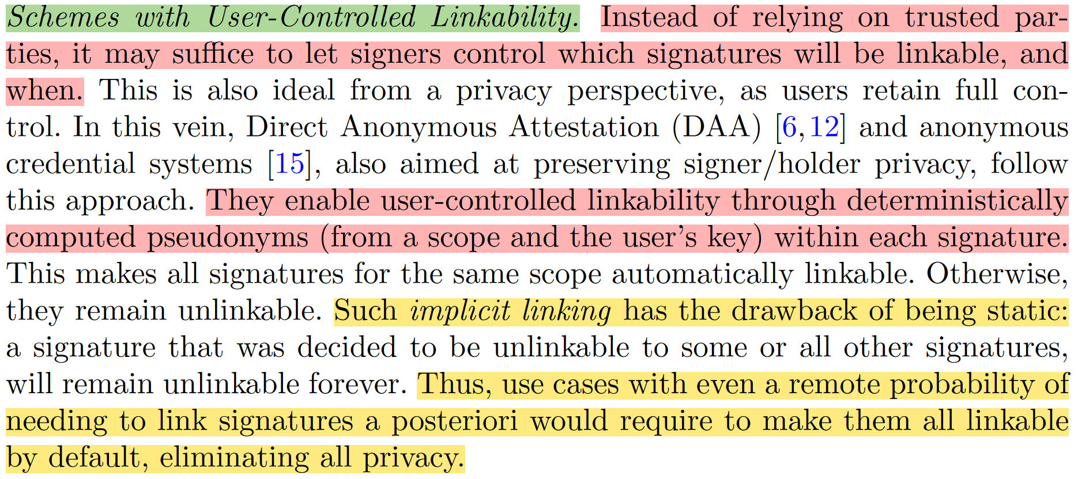
Introduction

Slide 17
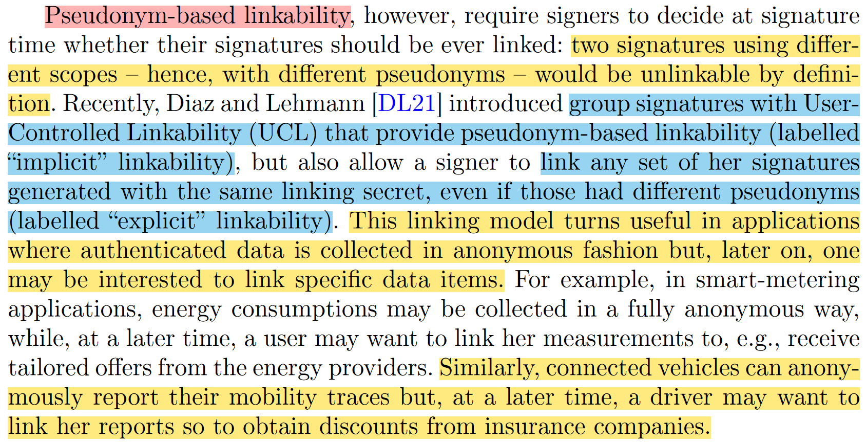
Introduction

Slide 18
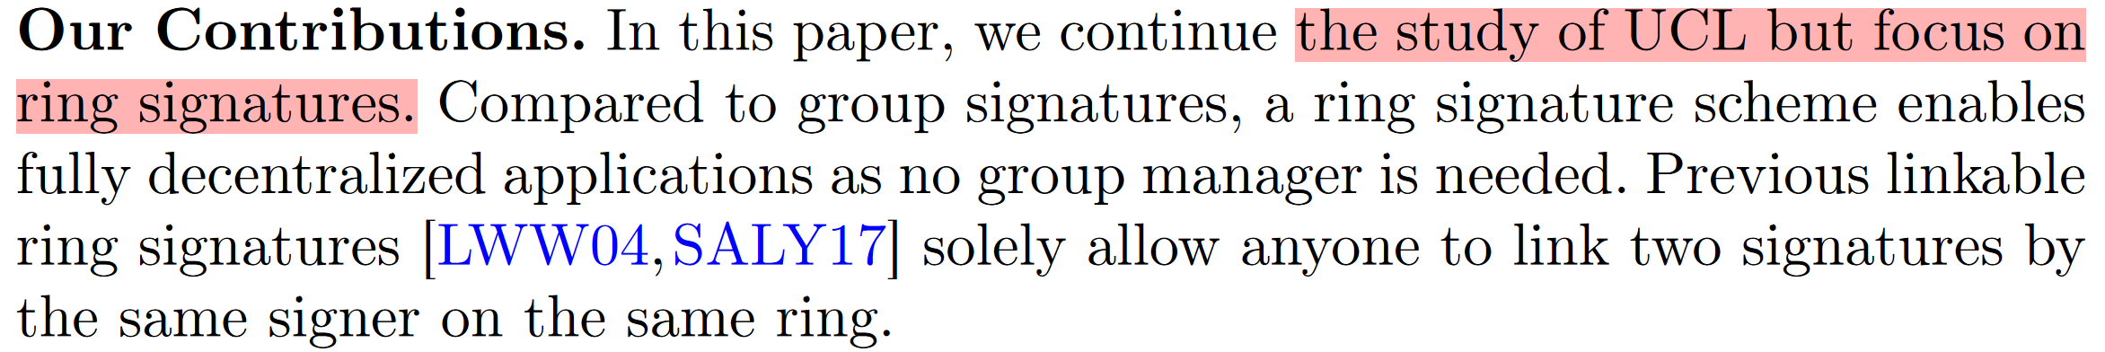
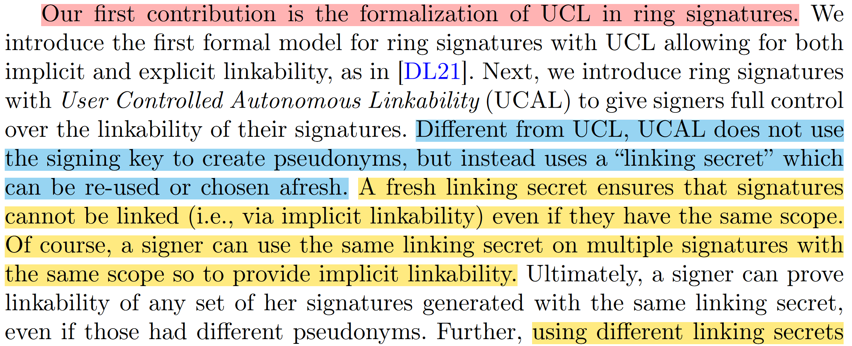
Contributions

Slide 19
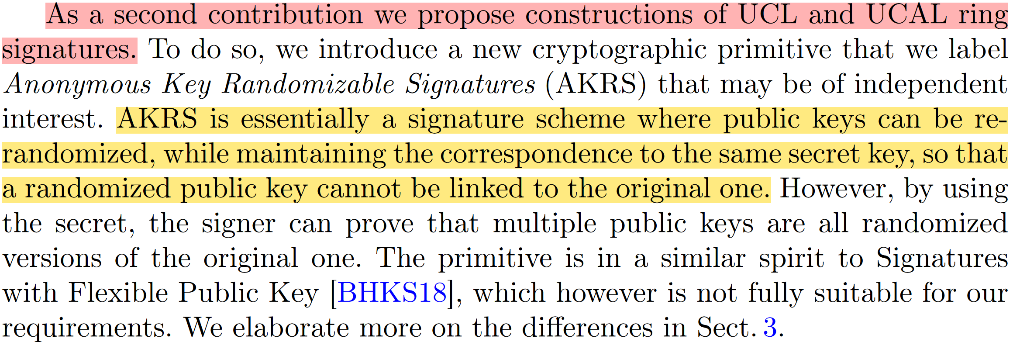
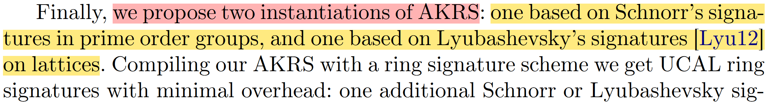
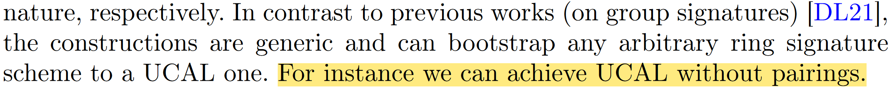
Contributions

Slide 20
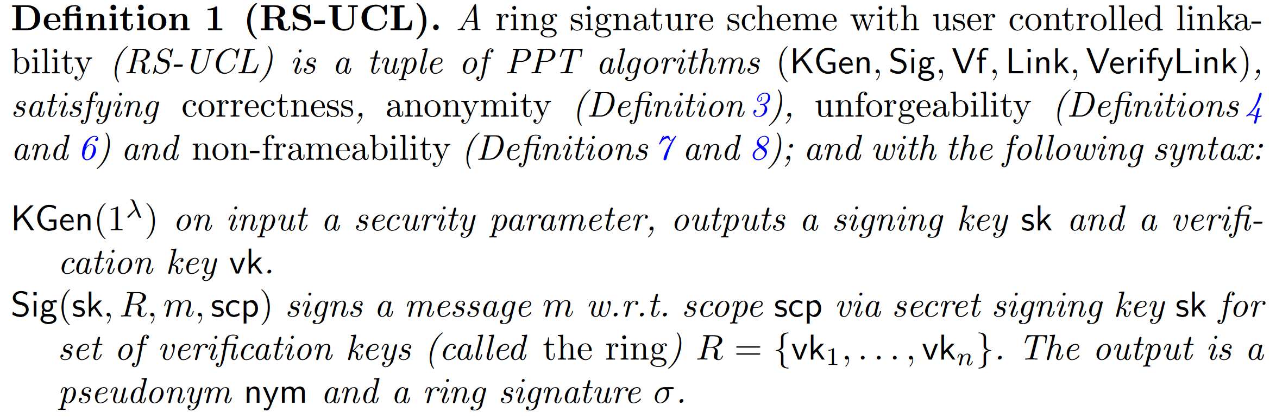
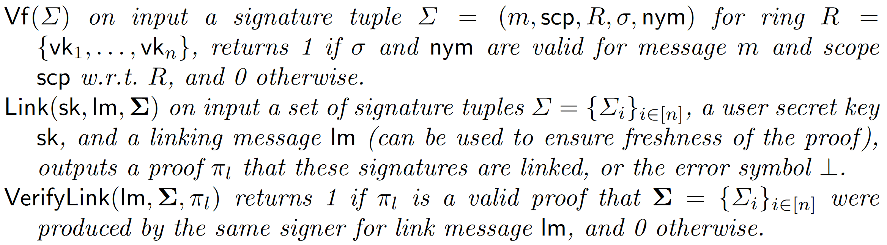
Ring Signatures with User-Controlled Linkability

Slide 21
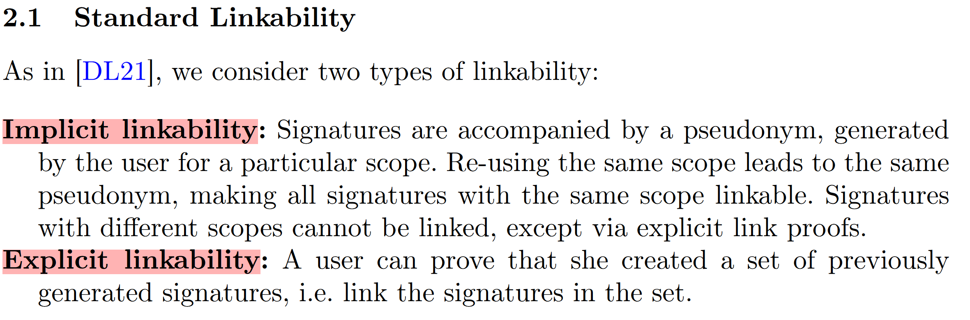
Ring Signatures with User-Controlled Linkability

Slide 22
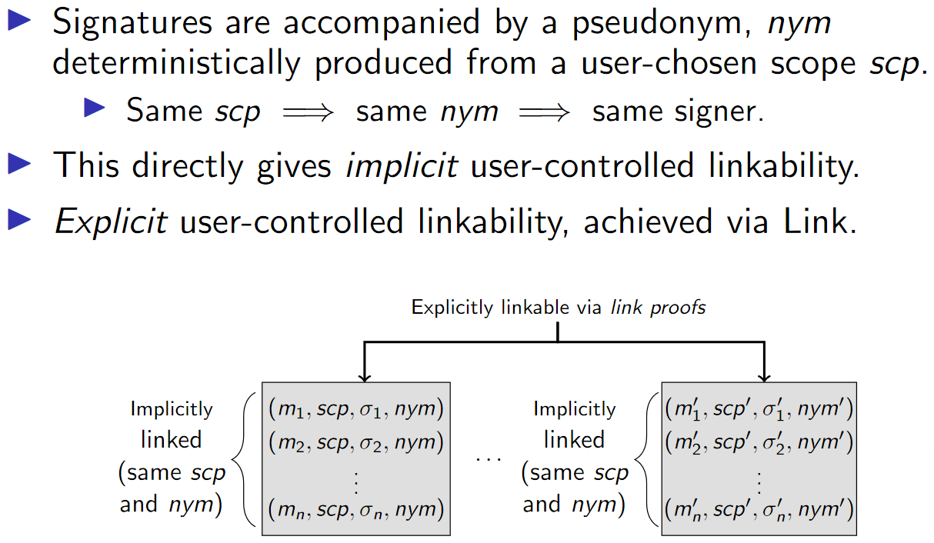
Ring Signatures with User-Controlled Linkability

Slide 23
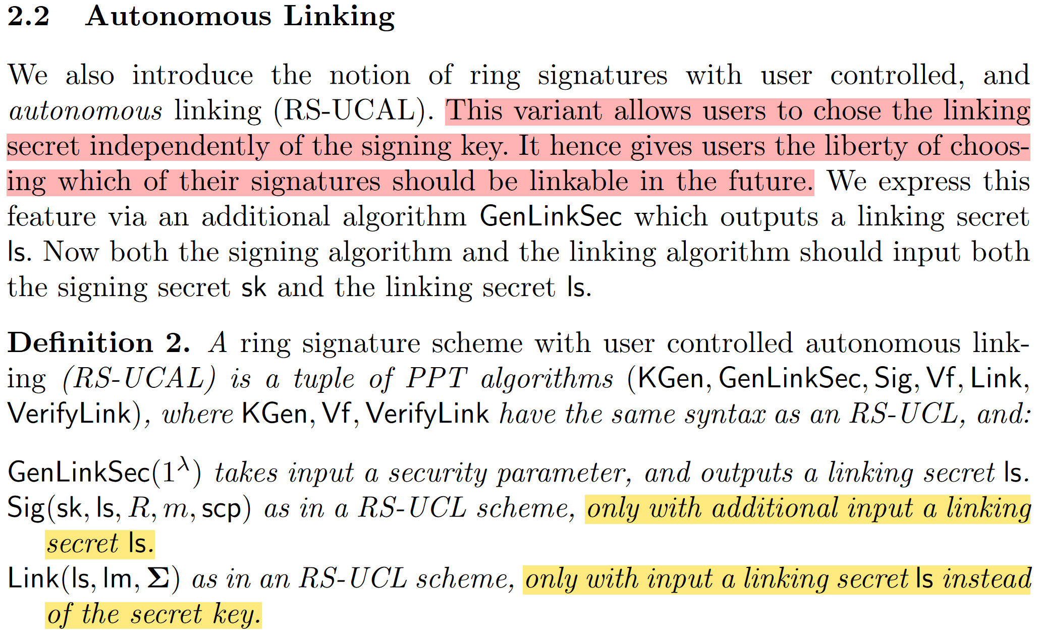
Ring Signatures with User-Controlled Linkability

Slide 24
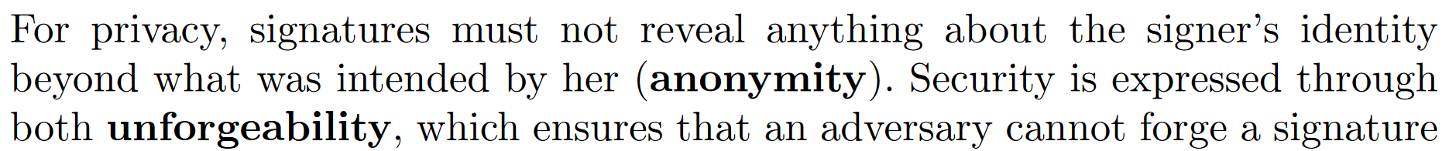
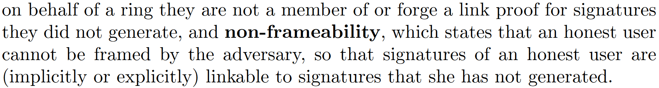
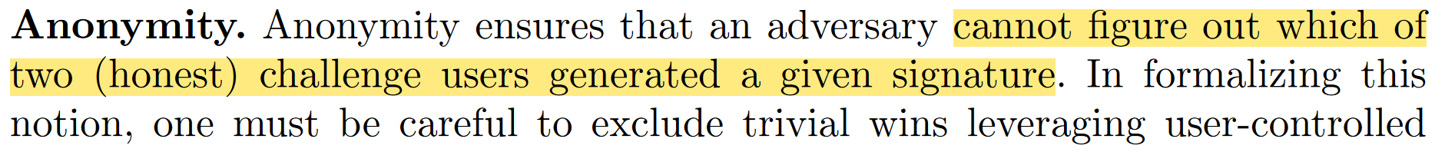
Ring Signatures with User-Controlled Linkability
Security Model

Slide 25
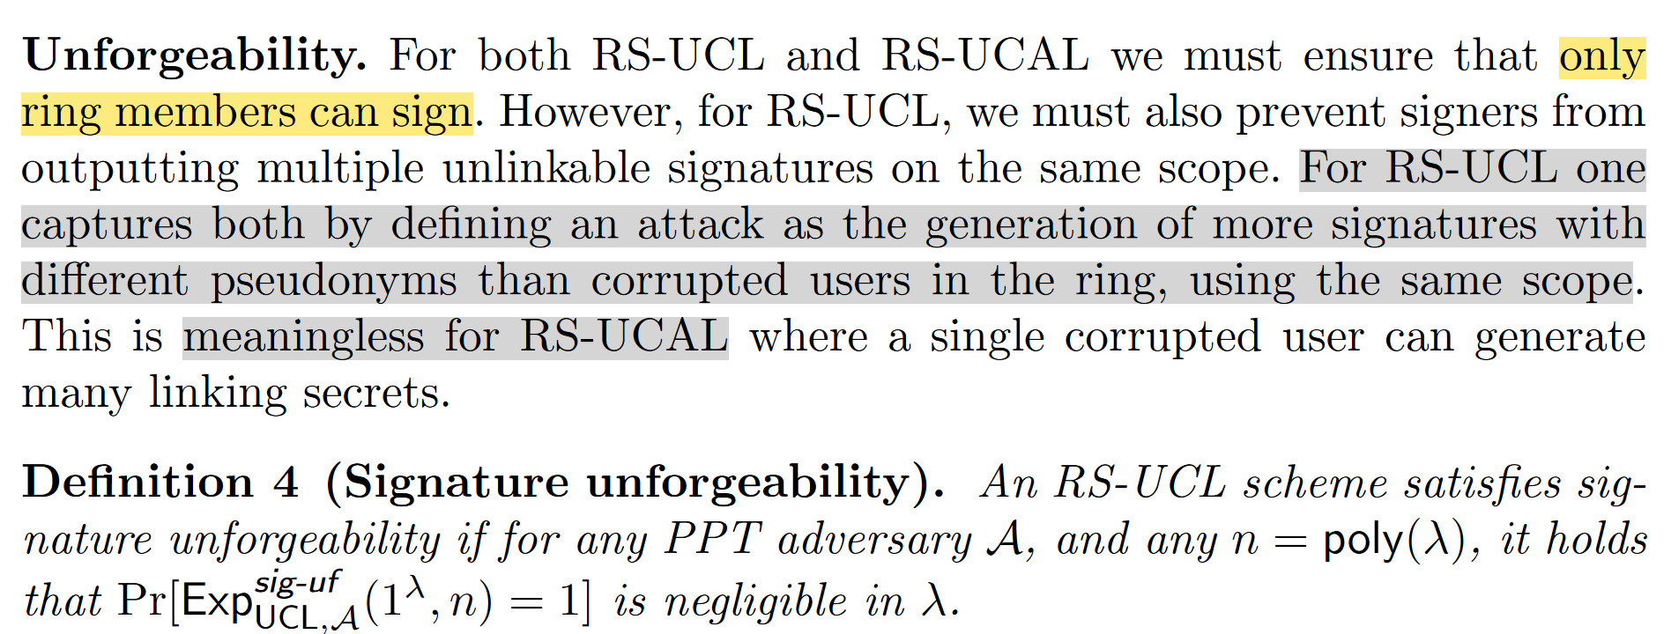
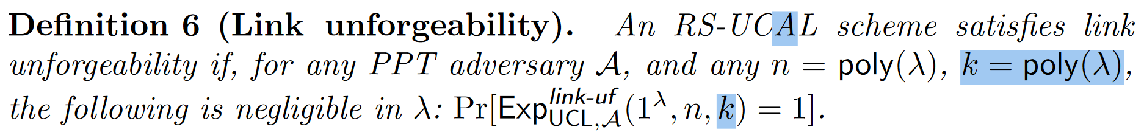
Ring Signatures with User-Controlled Linkability

Slide 26
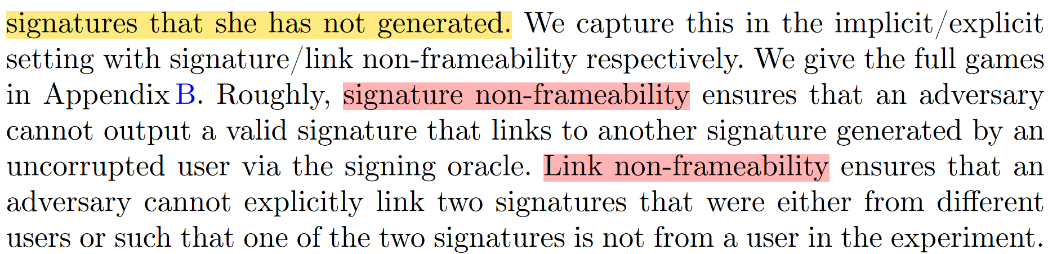
Ring Signatures with User-Controlled Linkability

Slide 27
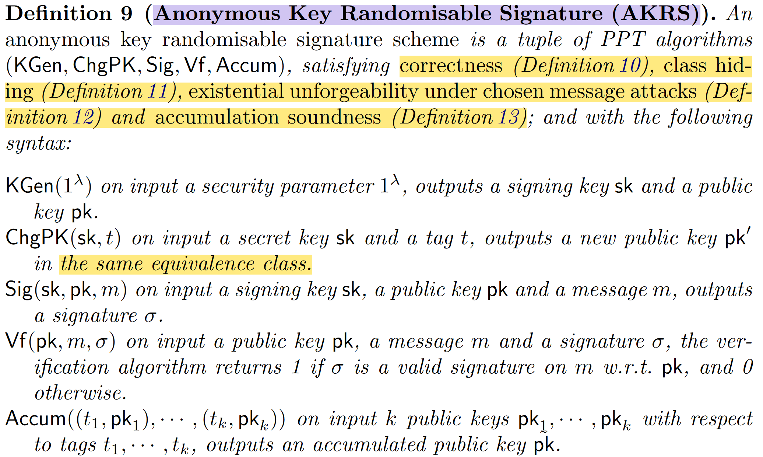
Anonymous Key Randomisable Signature (AKRS)
we allow for several key pairs in the same equivalence class to be accumulated into one key pair.

Slide 28
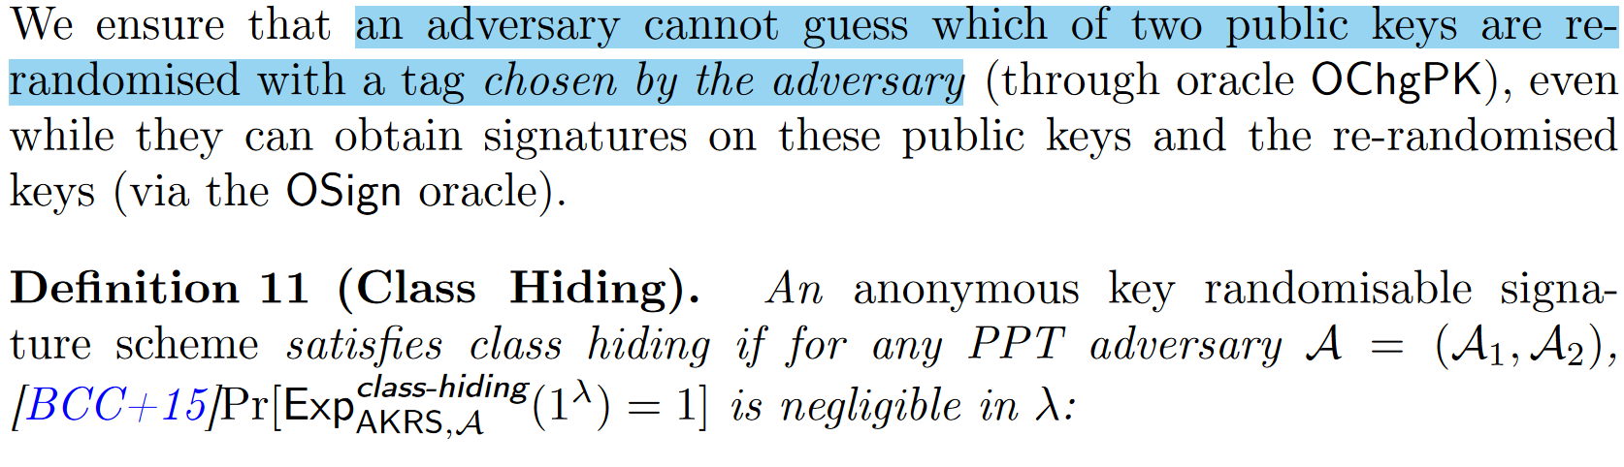
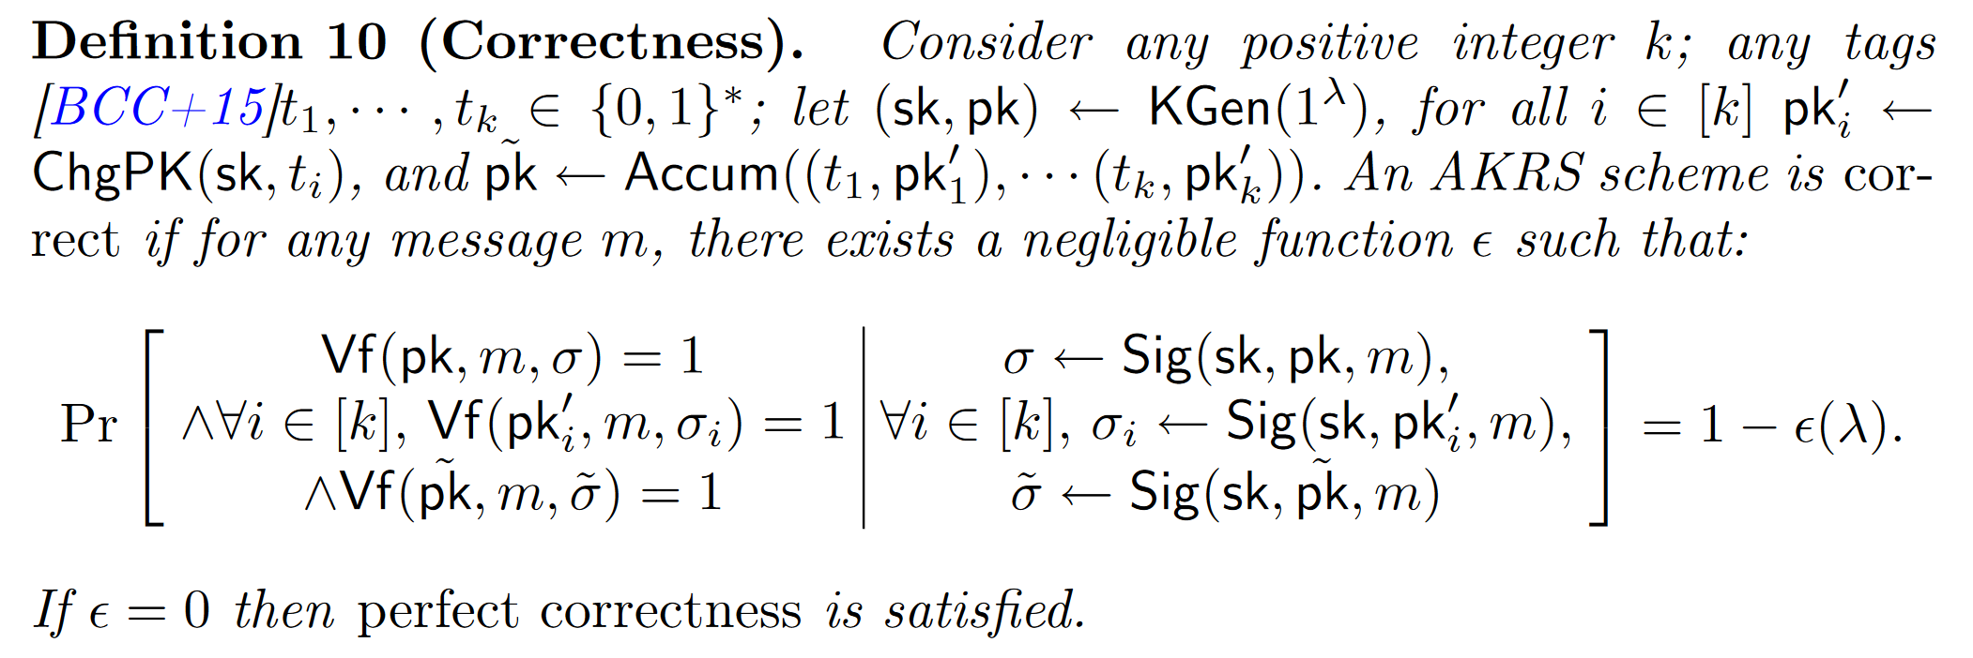
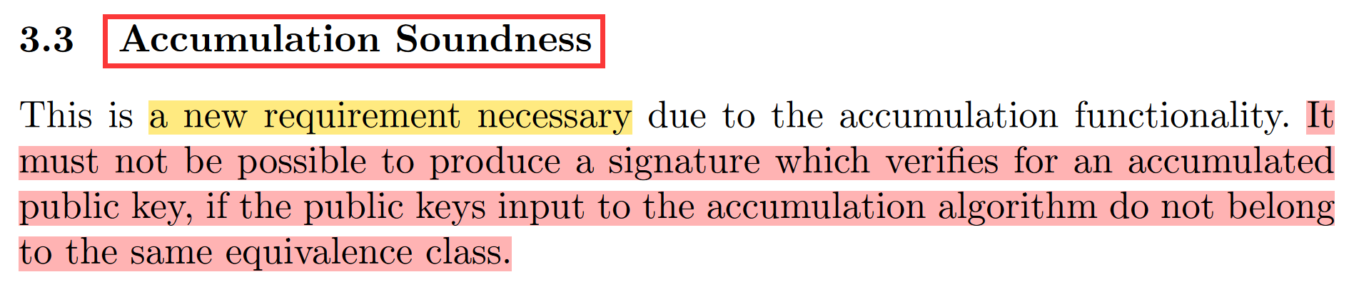
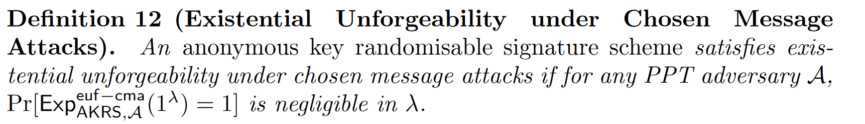
Anonymous Key Randomisable Signature (AKRS)

Slide 29
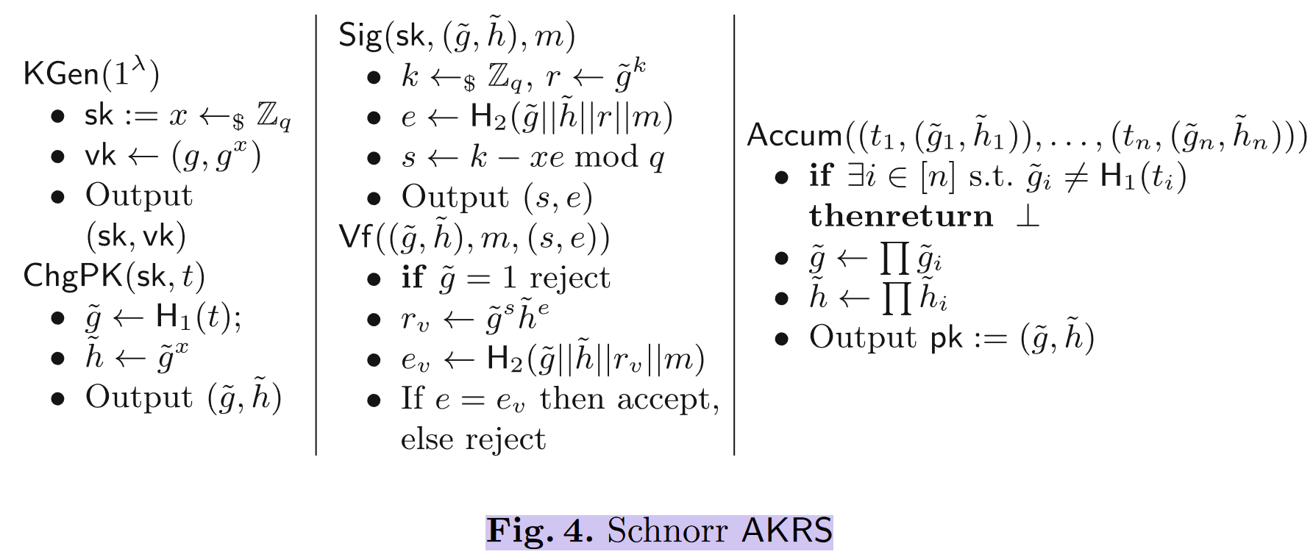
AKRS Instantiations—Construction from Schnorr Signatures

Slide 30
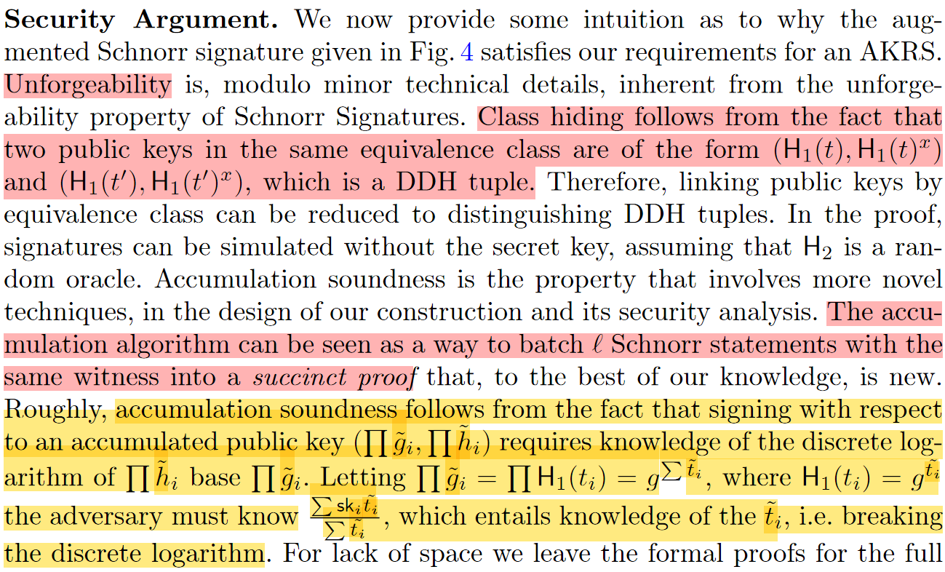
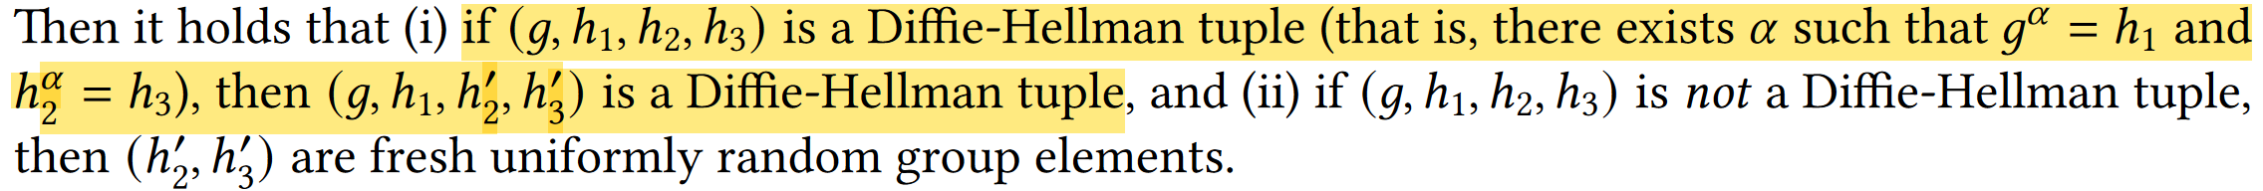
AKRS Instantiations—Construction from Schnorr Signatures
DDH tuples

Slide 31
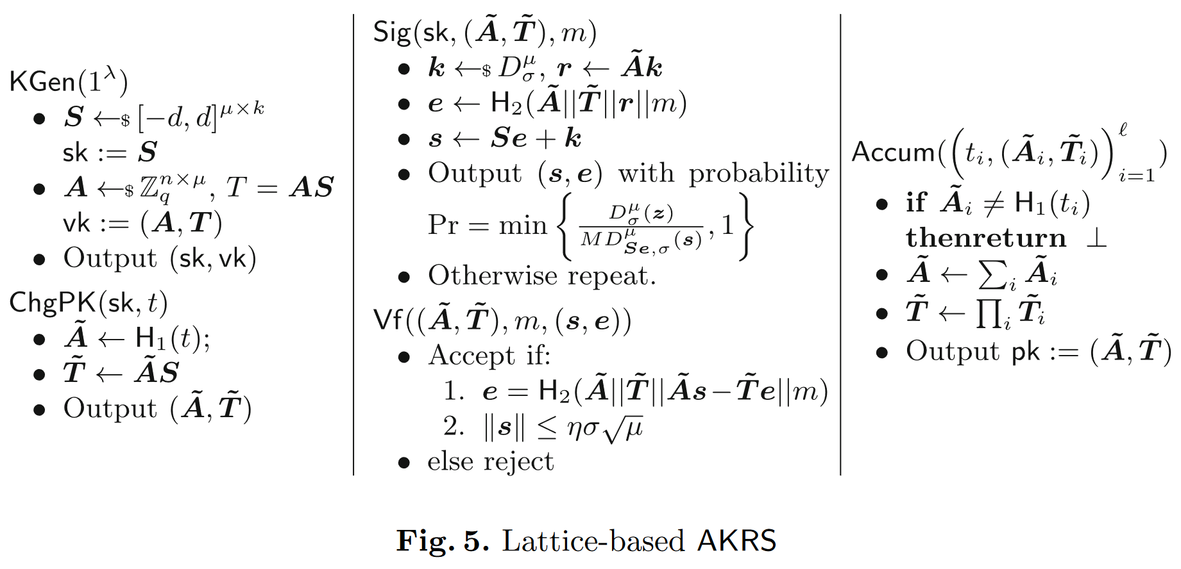
AKRS Instantiations—Construction from Lattice

Slide 32
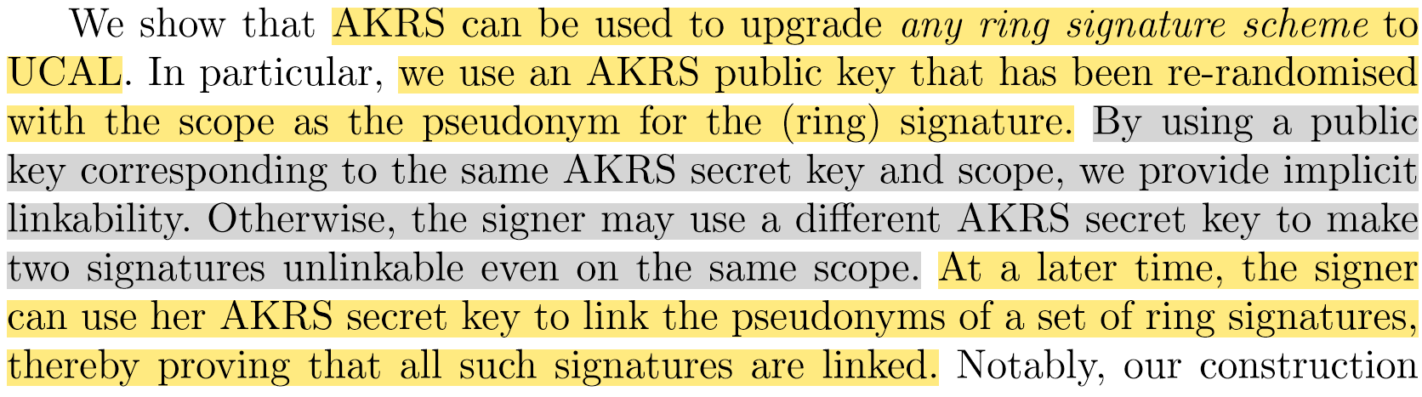
Ring Signatures with User-Controlled Linkability

Slide 33
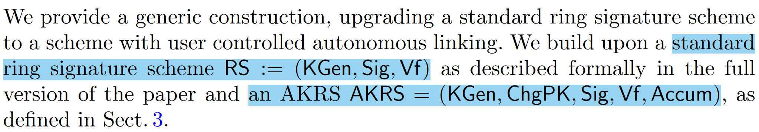
Ring Signatures with User-Controlled Linkability
构造一： RS with user controlled autonomous linking

Slide 34
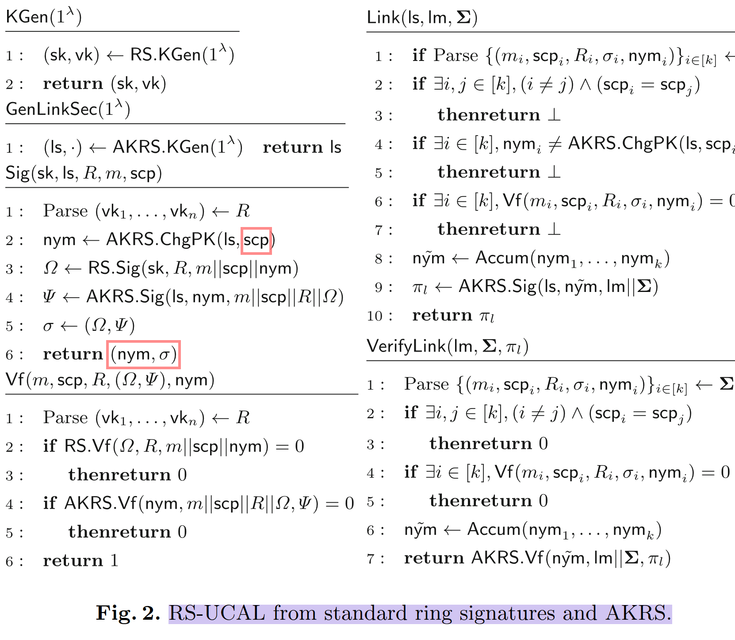
Ring Signatures with User-Controlled Linkability

Slide 35
Ring Signatures with User-Controlled Linkability
Signature unforgeability: included a standard ring signature to ensure that a non-member cannot sign on behalf of the ring.
Signature non-frameability: include an AKRS signature with respect to the pseudonym as the public key.
Explicitly linkability: we make use of the accumulation functionality from AKRS. A set of signatures that were all generated with the same linking secret contain pseudonyms that can be accumulated. This accumulated public key can be used to sign an AKRS signature, which will be the link proof.
Link non-frameability and link unforgeability: the accumulation soundness property and unforgeability of AKRS.
Anonymity: the anonymity of standard ring signatures, and the class hiding property of the AKRS.
Notes:
non-frameability attack, where an adversary uses the pseudonym of an honest user’s signature in their own signature

Slide 36
Ring Signatures with User-Controlled Linkability
构造二： RS with user controlled linking

Slide 37
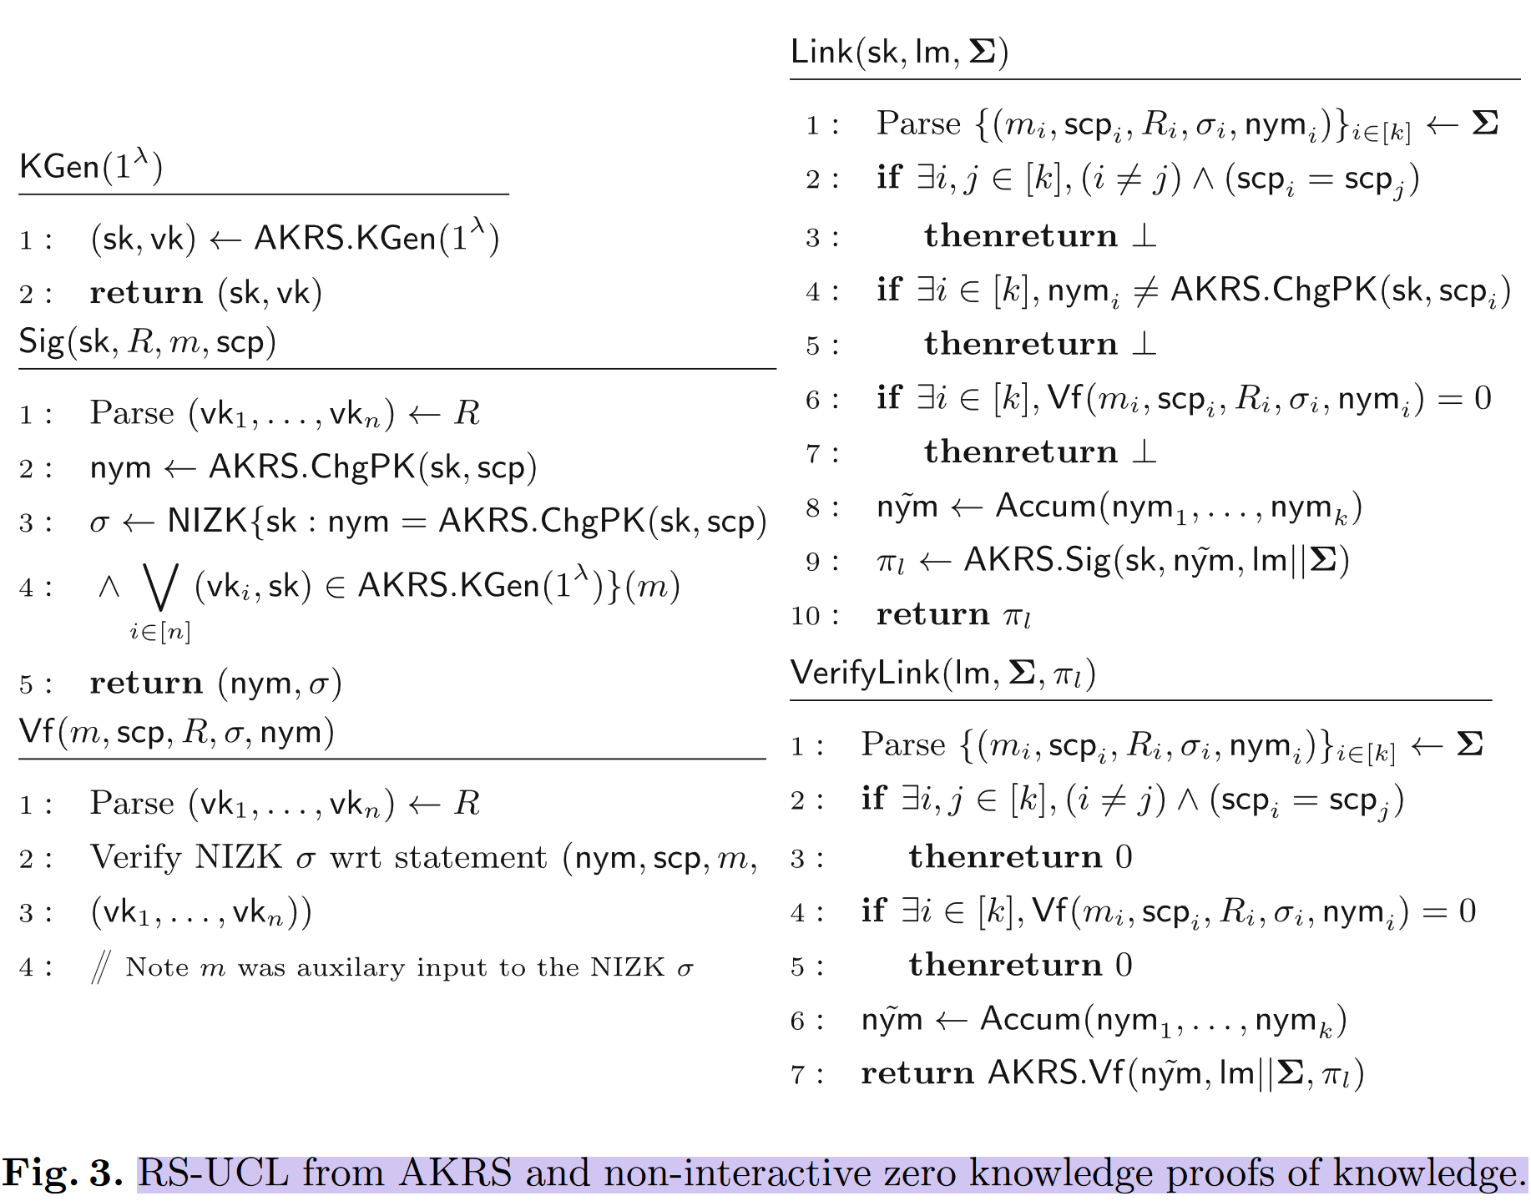
Ring Signatures with User-Controlled Linkability

Slide 38
Ring Signatures with User-Controlled Linkability
Signature unforgeability and non-frameability: additionally need to prove that the pseudonym was generated with a secret key corresponding to one of the public keys in the ring. —— a non-interactive zero-knowledge proof of knowledge that attests to this, which also fulfills the role of the ring signature.
Explicitly linkability: we make use of the accumulation functionality from AKRS. A set of signatures that were all generated with the same linking secret contain pseudonyms that can be accumulated. This accumulated public key can be used to sign an AKRS signature, which will be the link proof.
Link non-frameability and link unforgeability: the accumulation soundness property and unforgeability of AKRS.
Anonymity: the class hiding property of the AKRS, and the zero knowledge property of the NIZK.

Slide 39
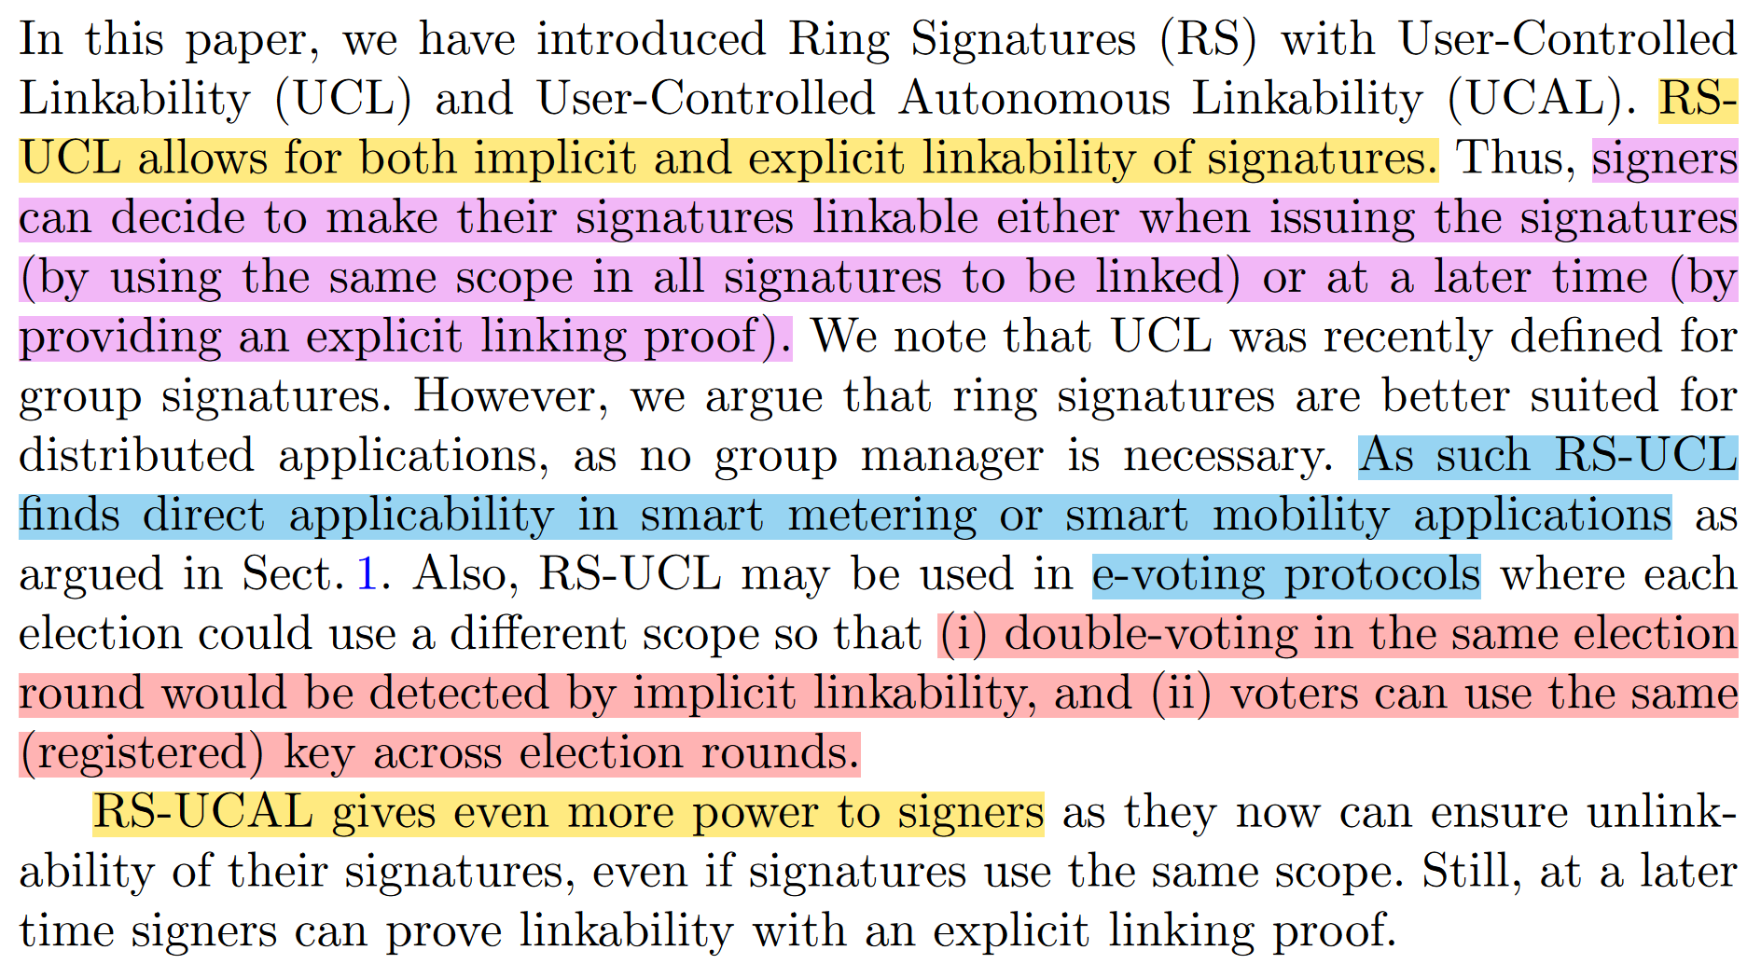
Conclusions

Slide 40
THANK YOU!
Questions?

